Slide 1

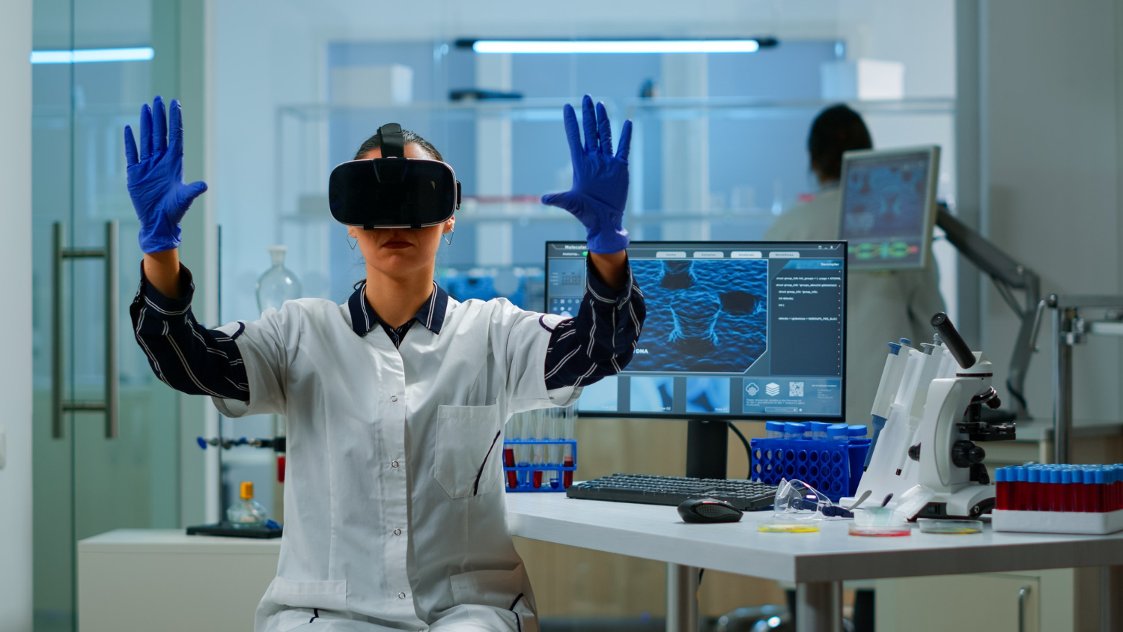


Annasaheb Dange College of Engineering and Technology, Ashta.
Artificial Intelligence and Data Science
Innovation Prototype
TOPIC NAME – AI HEALTHCARE CHATBOT.
Presented By:
1.Prathamesh Jadhav (2026)
2.Shivtej Sul (2029)
3.Samadhan Lade (2031)
Guided By:
Ms.Tejswini S Danwadkar

Slide 2

AI Chatbot
In Healthcare

Slide 3

Introduction
The intersection of artificial intelligence and healthcare marks a significant turning point in the development of patient care. We are living in a revolutionary time, as chatbots driven by AI are changing the face of healthcare. These chatbots, which have sophisticated machine learning and natural language processing skills, have the potential to completely change how people interact with healthcare professionals, obtain information, and receive support.

Slide 4
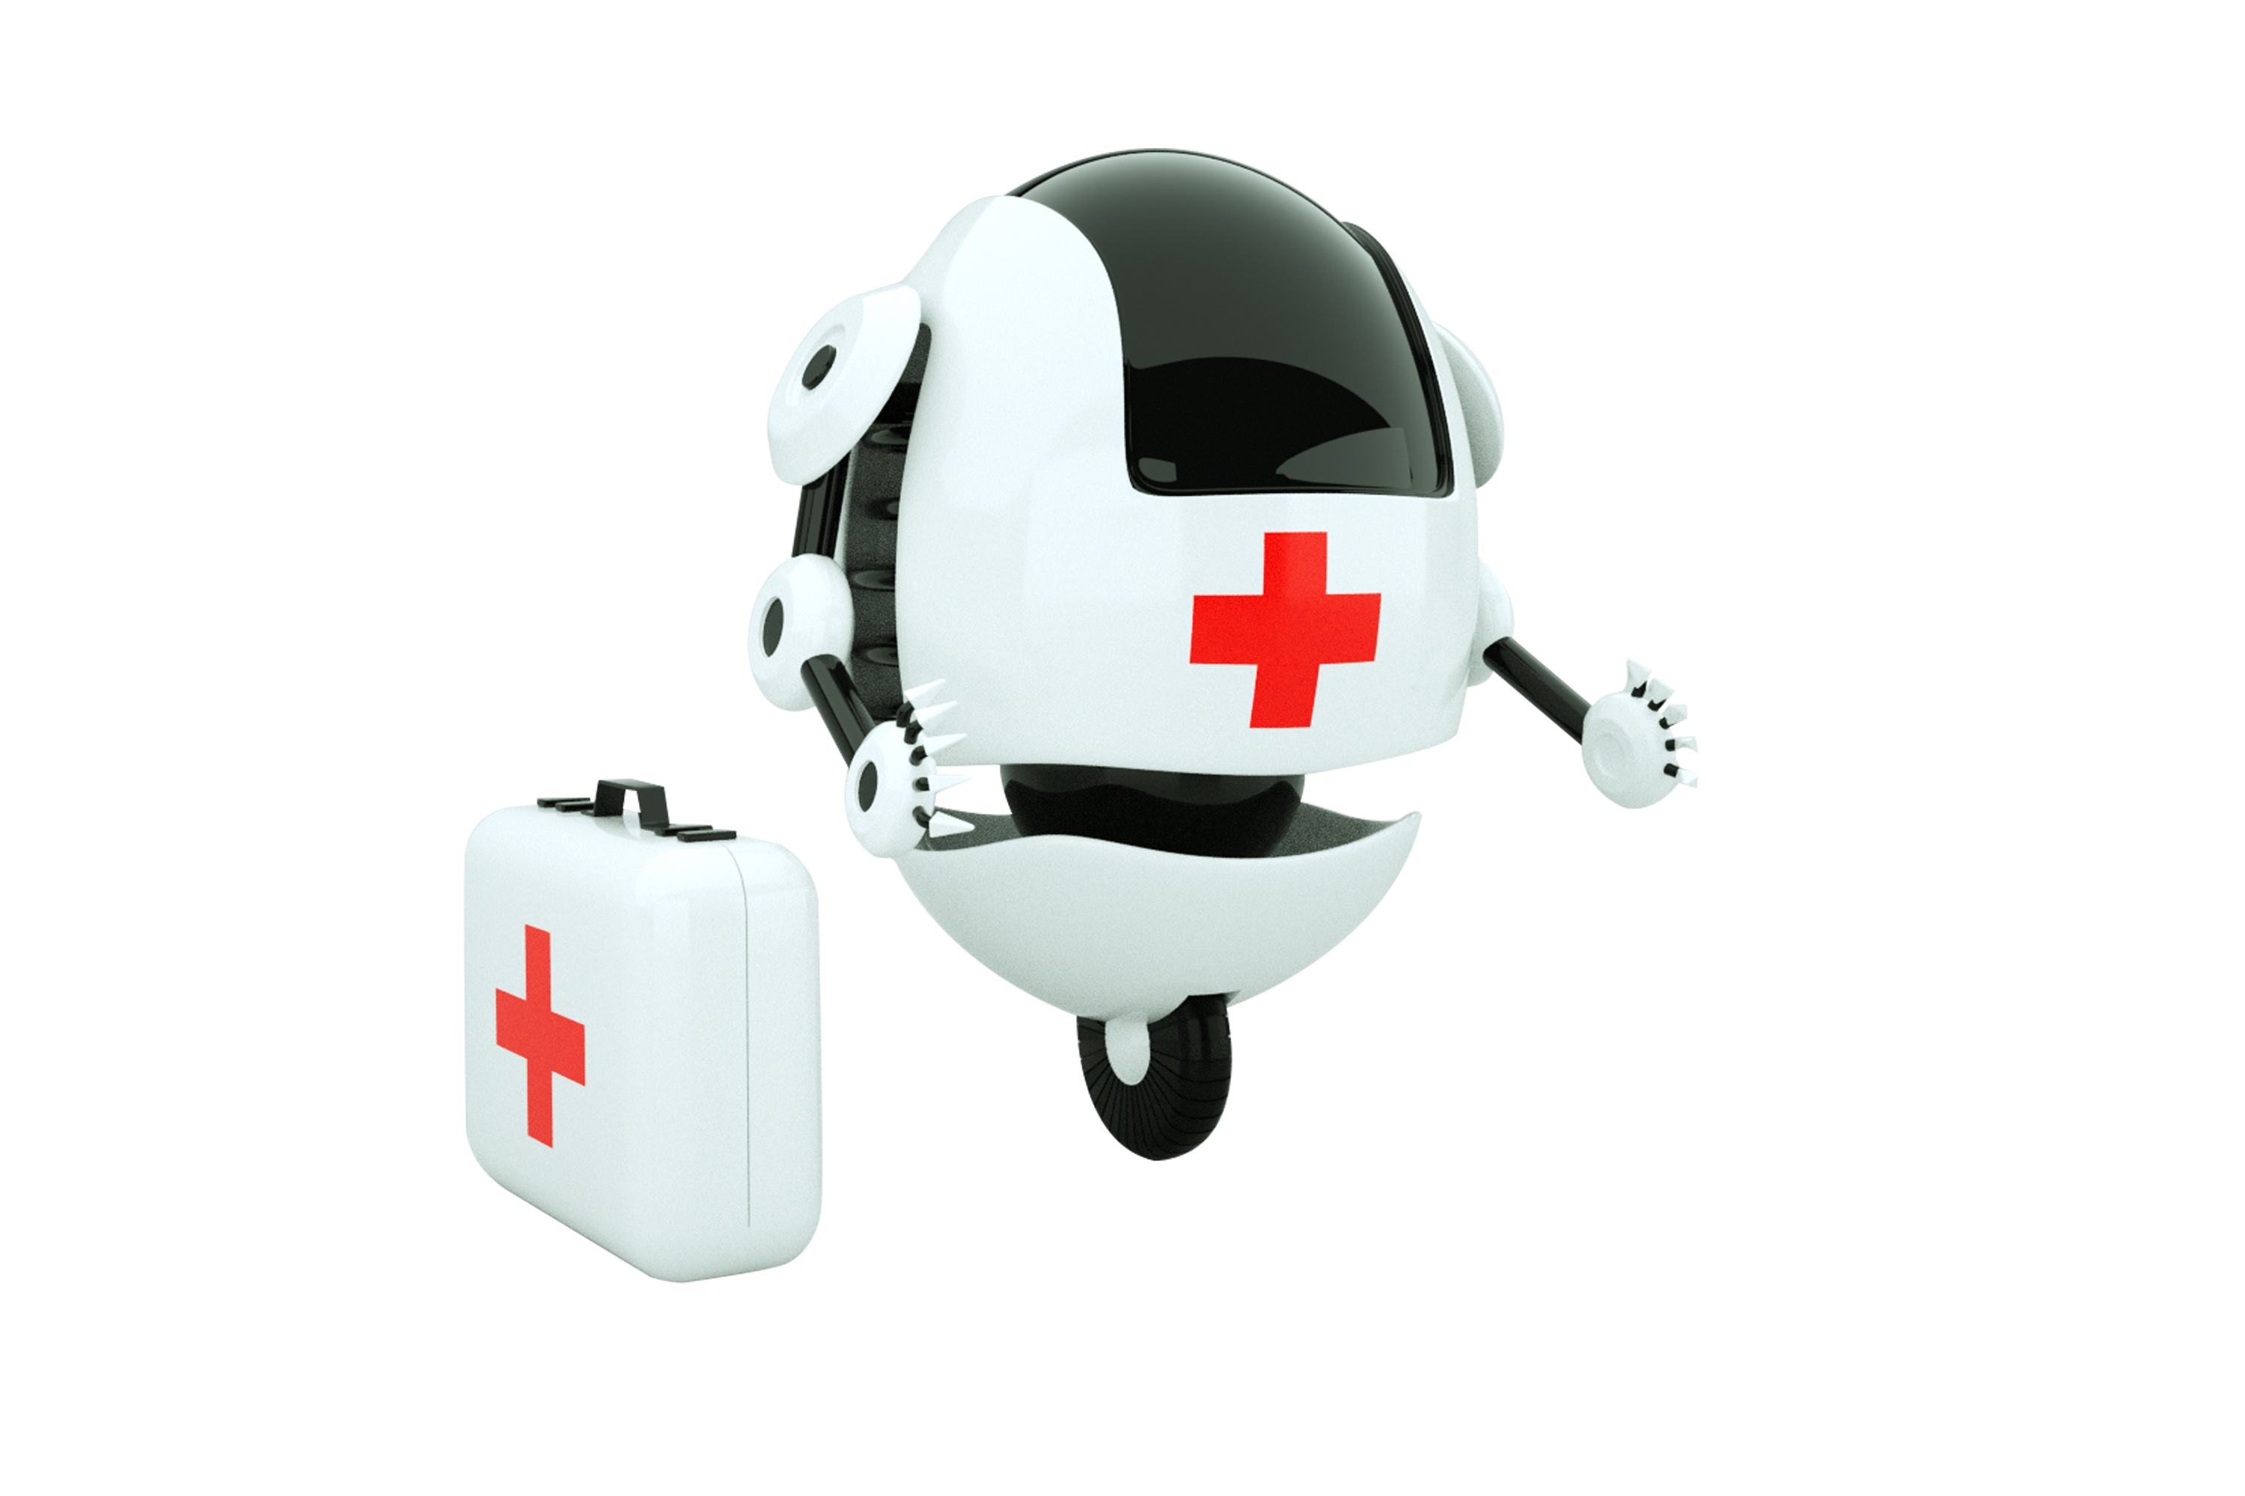
Literature Review
Evidence-based Research | Technological Evolution | User Experiences
Explore studies, articles, and papers on the efficiency and advancements in medical chatbots. | Review how medical chatbots have evolved over time, embracing technologies and adapting to patient needs. | Understand patient and physician feedback, highlighting the advantages and drawbacks of chatbot interaction.

Slide 5
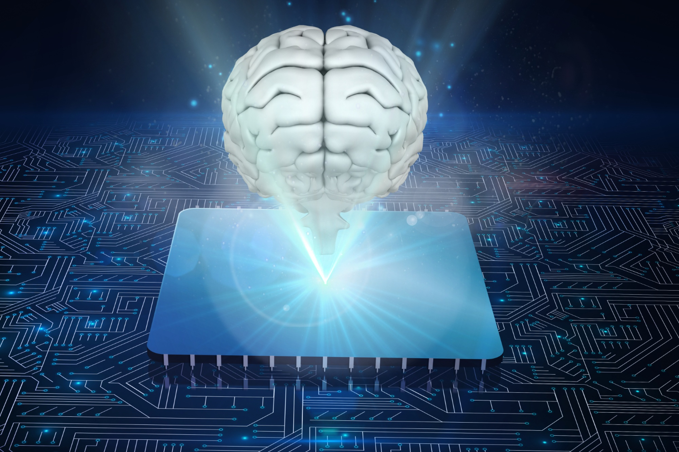
Research Gaps and Issues
Reliability Concerns:
Determine the ambiguities and problems related to the correctness and dependability of medical chatbot responses.
Communication Challenges:
Find out what stands in the way of people and chatbots having successful conversations and understanding.
3. Data Privacy:
Examine the security holes and privacy issues related to the information exchanged on medical chatbot platforms.

Slide 6
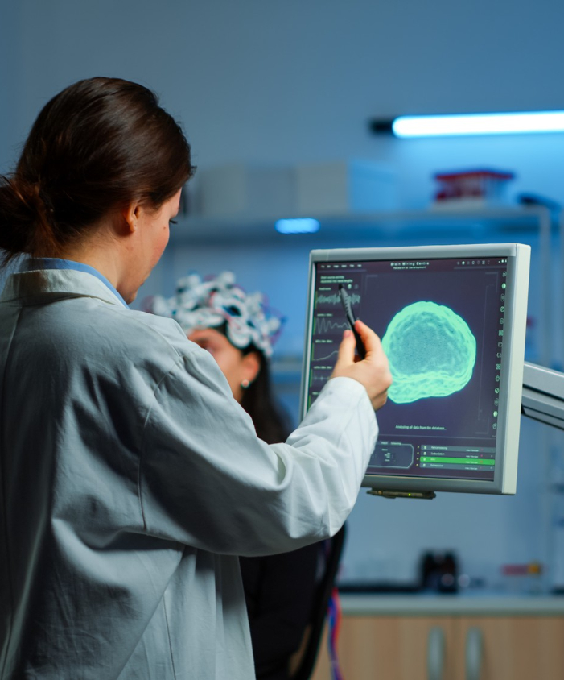
Problem Definition
ffrherhtrhaaaass
Identification:
Understanding the key problems in the existing healthcare system that could be addressed by chatbots.
Analysis:
examining the shortcomings and inefficiencies that exist in the current patient-doctor relationship.
Impact:
evaluating the possible advantages of introducing chatbots into the healthcare sector.

Slide 7

Research Objective
Our project's AI healthcare chatbot seeks to:
Increase patient happiness and engagement by offering prompt, individualized assistance.
Increase the efficiency and accessibility of healthcare by disseminating information and providing automated support.
Give patients the tools they need to make wise decisions about their health and wellbeing.
Work together with medical professionals to enhance clinical processes and enhance patient results.

Slide 8

Input Processing:
accepting and interpreting user input to provide sufficient comprehension.
Knowledge Base:
Integration with large-scale databases and libraries of medical knowledge.
Response Generation:
creation of precise and customized answers to customer questions or issuescreation of precise and customized answers to customer questions or issues
PROPOSED SYSTEM ARCHITECTURE

Slide 9




Results and Discussion
Data Analysis:
investigating and analyzing the results and patterns found in interactions between patients and chatbots.
User Feedback:
Recognizing the reactions and experiences of medical professionals and patients.
Improvement Strategies:
Identifying and implementing enhancements based on the feedback and performance data.

Slide 10

Conclusion
Conclusion:
Healthcare chatbots powered by AI provide effective, tailored service, but they also have issues with data protection and regulatory compliance. Subsequent developments may guarantee ethical adherence, boost decision support, personalize better, integrate with wearables, and carry out long-term research for more accurate assessment.
:

Slide 11
Future Scope
Future Scope:
Context Awareness and Personalization
Integration with Internet of Things and Wearables
Better Clinical Guidance Assistance
Regulatory and Ethical Considerations
Longitudinal Research and Assessment

Slide 12
References
YOUTUBE CHANNEL:
https://www.youtube.com/live/Fe5B90R8DTg?si=yu29ohif9M5EeKH7
https://www.youtube.com/live/7MN888ViS3I?si=0Ec6BLvO8YZw2Wj2
ARTICLES:
https://www.ncbi.nlm.nih.gov/pmc/articles/PMC10367431/
https://ieeexplore.ieee.org/document/9197833

Slide 13


